Slide 1
Chapter 7 sequential logic design principles
state, state variable, state machine
latches, flip-flops
analysis
synthesis

Slide 2
homework
Part 1: 7.4, 7.6, 7.8, 7.12, 7.15, 7.17, 7.19,
Part 2: 7.21(a, b), 7.44, 7.46, 7.47, 7.52, 7.54,

Slide 3
sequential circuit
the outputs depend not only on its current inputs, but also on the past sequence of inputs, possibly arbitrarily far back in time.
Inputs
Outputs
Combinational
Logic
Memory units : store data

Slide 4
Some important concepts
state and state variable
state : collection of state variable, contain all the information about the past necessary to account for the circuit’s future behaviors.
state variable: the symbol representation of state.
finite-state machine
the states of a sequential circuit is always finite.
n state variables
2^{n} possible states

Slide 5
Some important concepts
clock
a clock signal is a signal used to coordinate the actions of two or more sequential units.
clocked synchronous state machine
all memories of the sequential circuit change their outputs only on a clock edge or signal level.
coordinate by signal level
coordinate by signal rising edge or falling edge
H
L

Slide 6
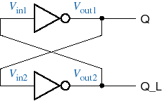
7.1 Bistable Element
1
Q is the state variable
feedback
2
Output variable：Q，Q_L，and Q_L=Q’
Two stable states:
Q=0、Q_L=1
Q=1、Q_L=0
a bistable storage element

Slide 7
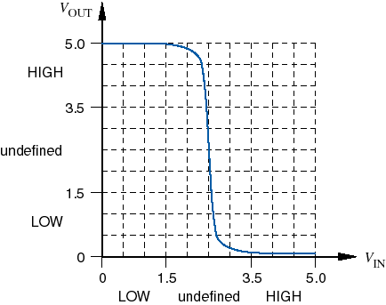
analysis with transfer characteristic
V_{IN}
V_{OUT}
V_{I1}
V_{O1}
1
V_{O2}
V_{I2}
2
stable
V_{O1}=V_{I2}
INV₁
meta-stable
INV₂
stable
V_{OUT}=T(V_{IN})
O
V_{I1}=V_{O2}

Slide 8
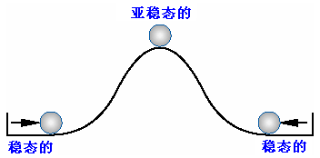
Stable and metastable

Slide 9
7.2 Latches and Flip_Flops
basic building block
be classified as S-R、D、T、J-K types
definition:
latch：watches the circuit’s inputs continuously and can changes the outputs at any time.
flip-flops：samples the circuit’s inputs and changes the output only when a clocking signal is changing.

Slide 10


Exp: a kind of “assert”, “abort” button
·press “ok”, light turns on
·press “abort”, light turns off
Vcc
Vcc
ok
ok
1
0
abort
abort
“ok” button released – light stays on
“abort” button released – light stays off

Slide 11
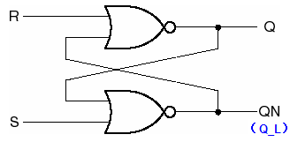
1、S—R Latches
S-R latch built with NOR gates
Function table
S | R | Q | Q_L
0 | 0 | Last Q | lastQ_L
0 | 1 | 0 | 1
1 | 0 | 1 | 0
1 | 1 | 0 | 0
hold
1
reset
set
2
forbidden
Q=QN’=Q_L’
the state variable Q can store 1-bit data.
S
Q
R
Q

Slide 12
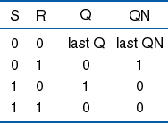
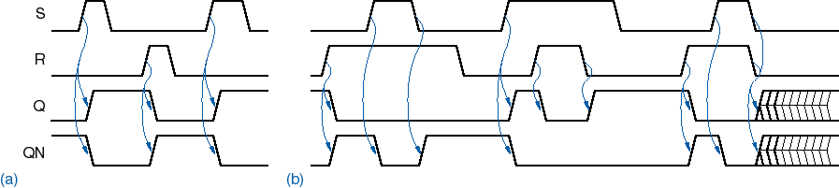
S-R latch’s timing analysis
meta-stable

Slide 13
Vcc
abort
R
Q
ok
S

Slide 14
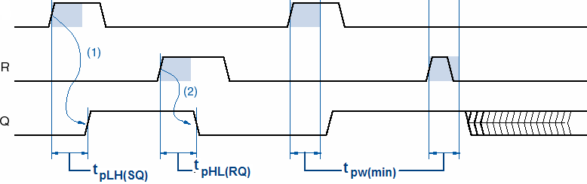
(2) minimum pulse width
S
propagation delay is exist when a transition on S or R input produce a transition on an output signal.
the time of active level of S or R must be keeping longer than minimum pulse width, or else the latch may be go into metastable.

Slide 15
(3) characteristic equation
current state
next state
Q | S | R
0 | 0 | 0
0 | 0 | 1
0 | 1 | 0
0 | 1 | 1
1 | 0 | 0
1 | 0 | 1
1 | 1 | 0
1 | 1 | 1
Q*
0
0
1
d
1
0
1
d
characteristic equation for S-R latch:
Q*=S+R’ ·Q （S·R=0）
S=R=1, restricted combination

Slide 16
2、S-R latch
built with NAND gates
S_L | R_L | Q | Q_L
0 | 0 | 1 | 1
0 | 1 | 1 | 0
1 | 0 | 0 | 1
1 | 1 | Last Q | lastQ_L
S_L
S
Q
Q
forbidden
R_L
R
Q
Q_L
set
reset
S_L 、R_L: active low signals
hold

Slide 17
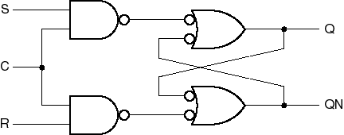
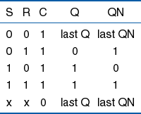
3、S-R latch with enable
S
Q
C
R
Q
forbidden
metastable still exist

Slide 18
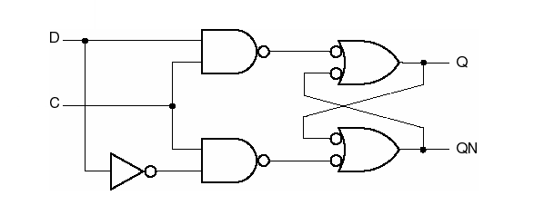
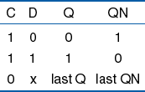
4、D latch
S
R
保持
when C=0，the data is latched on Q .
D
Q
characteristic equation
Q*=D （C=1）
transfer data transparently
C
Q

Slide 19
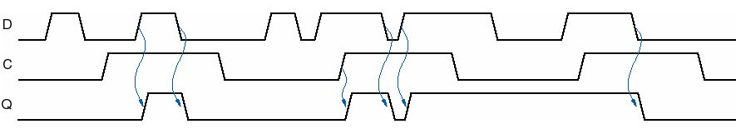
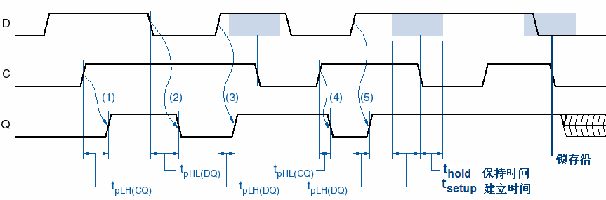
timing diagram
data transfered
data latched
if D changes during the t_{hold} and t_{setup}, the output may become metastable.

Slide 20
5、Edge-Triggered D Flip-Flops
Edge-Triggered ：output of flip-flop changes on the clock signal’s rising edge or falling edge.
positive edge （rising edge）
negative edge （falling edge）
CLOCK

Slide 21
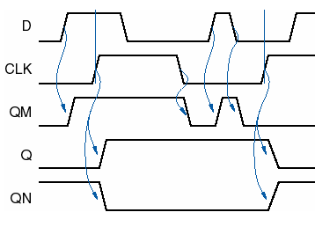
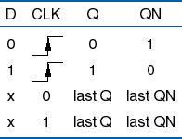
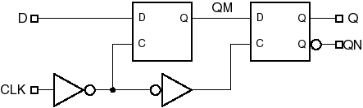
positive-edge-triggered D flip-flop
U_{M}
U_{S}
master-slave structure
CLK=0，QM=D，U_{S} hold last Q；
At the clock’s rising edge, U_{S} enable， U_{M} hold last QM，Q=QM；
CLK=1， U_{M} hold last QM，so Q hold last Q。

Slide 22
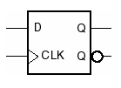

Only at the rising edge of clock signal, D input could be transferred to Q output.
Dynamic-input indicator, meaning edge-triggered.
Negative-edge-triggered D flip-flop

Slide 23
Others
edge-triggered D flip-flop with asynchronous inputs
PR
PR_L: preset
CLR_L: clear
D
Q
CLK
Q
CLR
Asynchronous inputs: force the output to go into a certain state with ignoring the triggering edge of clock.

Slide 24
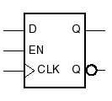
6、edge-triggered D flip-flop with enable
D | EN | CLK | Q | Q_L
0 | 1 |  | 0 | 1
1 | 1 |  | 1 | 0
× | 0 |  | last Q | last Q_L
× | × | 0 | last Q | last Q_L
× | × | 1 | last Q | last Q_L
characteristic equation ：Q*=EN·D+EN’·Q

Slide 25
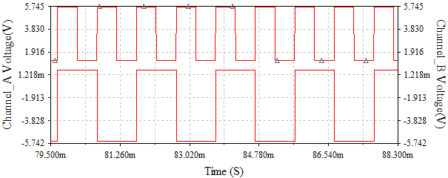
frequency divider with D f-fs
(frequency, f_{out})
D
Q
output
(frequency, f_{in})
input
CLK
Q
divide-by-2 divider

Slide 26
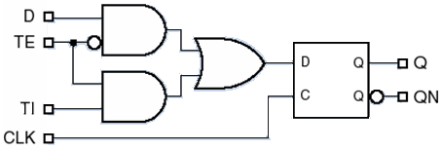
7、scan flip-flop
2-1 MUX
Normal input
D
Q
Test enable
TE
Q
Test input
TI
D
CLK
D
Q
Q
TI
TE
CLK
Q_L
CLK
TE=1，test operation mode，f-fs take TI data.
TE=0，normal D f-f-s，take D data.

Slide 27
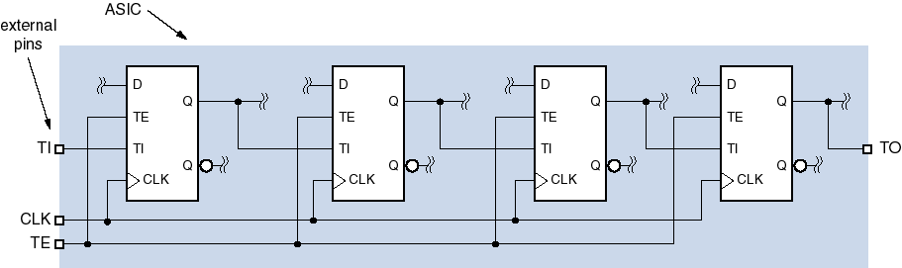

Slide 28
8、master/slave S-R Flip-Flops
Master
Slave
QM
Q
S
S
Q
S
Q
S
Q
C
QM_L
C
C
R
R
Q
R
Q
Q_L
R
Q
C
Q*=S+R’ ·Q （S·R=0）
C=1, master is enabled and stores new data;
C= 0, master’s state is passed to enabled slave and slave stores the new value.
It is not edge-triggered f-fs, but pulse-triggered.

Slide 29
Timing diagram of S-R f-fs
C
S
R
QM
QM_L
Q
Q_L

Slide 30
9. master/slave J-K flip-flop
stucture
S_{M}
Master
QM
Slave
S
Q
S
Q
Q
J
R_{M}
C
QM_L
C
K
Q
Q
Q_L
R
R
C
feedback
C=1，master is enabled and stores new data;
C = 0, slave is enabled and stores the data from master’s output

Slide 31
JK flip-flop timing diagram
S_{M}
QM
R_{M}
QM_L
C
J
K
QM
QM_L
Q
Q_L

Slide 32
features
J | K | C | Q | Q_L
× | × | 0 | last Q | last Q_L
0 | 0 |  | last Q | last Q_L
0 | 1 |  | 0 | 1
1 | 0 |  | 1 | 0
1 | 1 |  | last Q_L | last Q
Pulse-triggered f-f-s
hold
J
Q
hold
C
K
Q
reset
set
toggle
Characteristic equations ：
Q*=J·Q’+K’ ·Q
Eliminate the possible metastable which exist in the S-R f-fs (restricted input, S=R=1).
But, 1s catching and 0s catching are exist.

Slide 33
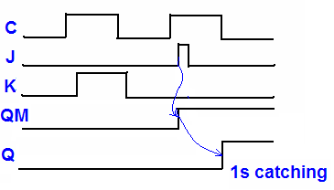
1s catching
When C=1， last Q=0
JK=0×
if J changes to 1
master catches the changing, and sets QM=1
Even though J=1 occurred for a short time and J changes to 0 later, QM doesn’t change to 0, and passes 1 to slave when C=0. So Q hold 1.

Slide 34
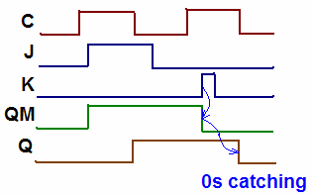
0s catching
When C=1, last Q=1
There be JK=×0, even if K changes to 1 for a short time，flip-flop would catch the changing，and set Q=0. K changes to 0 later，Q hold 0.

Slide 35
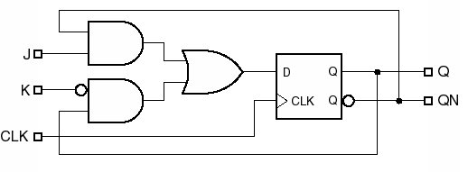
10、Edge-triggered J-K Flip-Flop
sample the inputs and change the output state at the edge of clock。
characteristic equations：
Q*=J·Q’+K’ ·Q
eliminate the “1s catching” and “0s catching”.
J
Q
CLK
K
Q
J
Q
CLK
Q
K

Slide 36
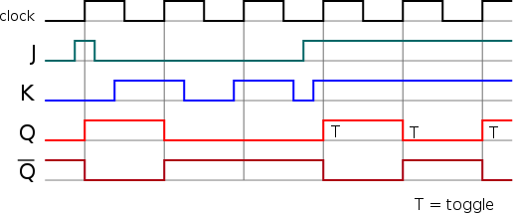
Timing diagram of edge-triggered J-K f-fs

Slide 37
11、T Flip-Flop
T: toggle
functional table
symbol
较为通用的符号
T
Q
CLK | T | Q | Q*
 | 1 | 0 | 1
 | 1 | 1 | 0
 | 0 | × | hold
CLK
Q
characteristic equation：Q*=T·Q’+T’ ·Q=T⊕Q
Q
本教材的符号
Q*=Q’
The internal structure :
Fig 7-32
T
CLK
Q

Slide 38
Implementation
Contribute by D or J-K f-fs.
T
Q
T
D
Q
Q
CLK
Q
CLK
CLK
Q
Q_L
功能等效
EN
Q
T
J
Q
Q
T
CLK
Q
CLK
CLK
K
Q
Q_L

Slide 39
T Flip-Flop with enable
EN
Q
EN=1，normal T flip-flop;
EN=0，hold the last value
T
CLK
Q
Q*=EN· (T⊕Q)+EN’ ·Q
大多数教材用的带使能的T触发器符号

Slide 40
summary : latches and flip-flops
classified in structure：
latches：S-R、D latches
flip-flops：S-R、D、J-K、T flip-flops
classified in triggering form：
pulse-triggered
edge-triggered
one latch or flip-flop is a memory elements
store one bit (0 or 1).
it also act as a state variable
more memory elements can be combined to store more bits which used to “remember” states in sequential circuit.

Slide 41
summary : characteristic equation
S-R latch
D latch
D flip-flop
D flip-flop with enable
M/S S-R flip-flop
M/S J-K flip-flop
edge-triggered J-K flip-flop
T flip-flop
Q*=S+R’·Q （S·R=0）
Q*=D
Q*=D
Q*=EN·D+EN’·Q
Q*=S+R’·Q （S·R=0）
Q*=J·Q’+K’·Q
Q*=J·Q’+K’·Q
Q*=T·Q’+T’ ·Q

Slide 42
7.3 clocked synchronous state-machine analysis
emphases：
Basic structure
Mealy machine
Moore machine.
understand the function of each module
Derive
excitation equations,
transition/ output table and equations
state table
state diagram
timing diagram, etc.

Slide 43
1、stucture
（1）Mealy machine
Next-state logic F
state memory clock
Output logic G
outputs
inputs
excitation
Current state
Clock signal
construct by combinational circuit, it output the excitation signal to storage element.
next state= F(current state,input)
construct by flip-flops, can store 2^{n} state at most
construct by combinational circuit,
output= G(current state, input)
back

Slide 44
（2）Moore machine
inputs
Next-state logic F
state memory clock
Current state
Output logic G
outputs
excitation
Clock signal
PS: output=G (current state)

Slide 45
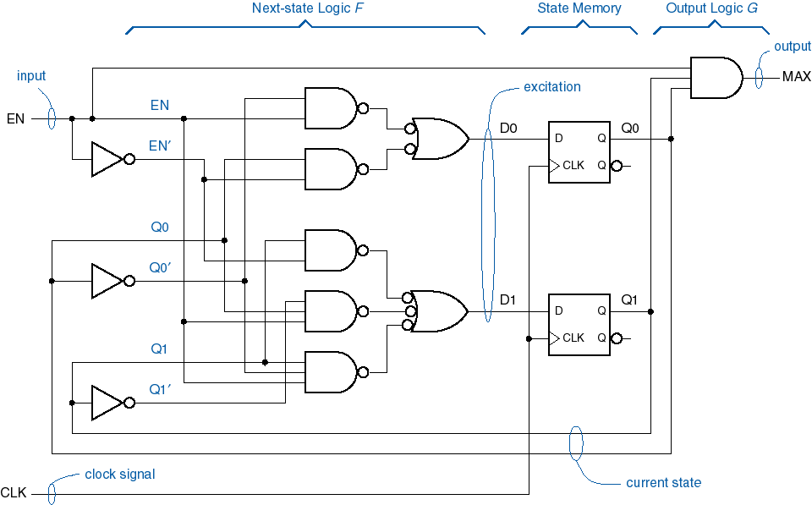
2.analysis example
Next-state logic
State memory
Output logic
state variable：Q0、Q1
excitation：D0、D1
output：MAX

Slide 46
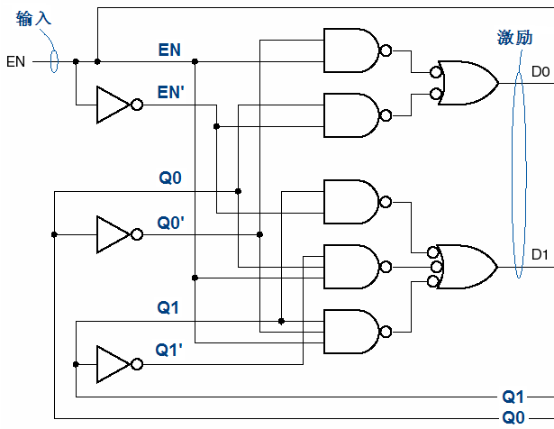
excitation equation
D0=F（EN，Q1，Q0）
=[(EN·Q0’)’]’+[(EN’·Q0)’]’
=EN·Q0’+EN’·QO
D1=F（EN，Q1，Q0）
=EN’·Q1+EN·Q1’·Q0
+EN·Q1·Q0’

Slide 47
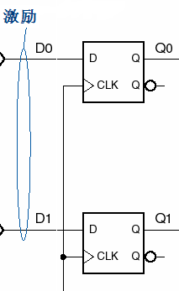
transition equation
Characteristic equation of D f-fs：Q*=D
Substituting the excitation equations for D
Transition equation：
Q1*=D1
= EN’·Q1+EN·Q1’·Q0+EN·Q1·Q0’
Q0*=D0
= EN·Q0’+EN’·QO

Slide 48
Transition table and state table
Transition equation ：
Q1*= EN’·Q1+EN·Q1’·Q0+EN·Q1·Q0’
Q0*= EN·Q0’+EN’·QO
State table
Transition table
Current state S | EN
 | 0 | 1
A | A | B
B | B | C
C | C | D
D | D | A
 | S*
Current state
input
Q1Q0 | EN
 | 0 | 1
00 | 00 | 01
01 | 01 | 10
10 | 10 | 11
11 | 11 | 00
 | Q1*Q0*
Assign state name to each state:
Q1Q0 S 00 A 01 B 10 C 11 D
Next state

Slide 49
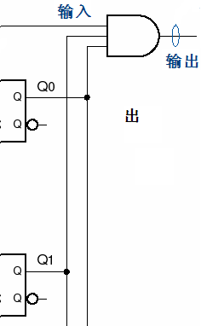
Output equation
EN
MAX
MAX=EN·Q1·Q0

Slide 50
Transition/output table, state/output table
Transition/output table
state/output table
Q1Q0 | EN
 | 0 | 1
00 | 00，0 | 01，0
01 | 01，0 | 10，0
10 | 10，0 | 11，0
11 | 11，0 | 00，1
 | Q1*Q0*，MAX
S | EN
 | 0 | 1
A | A，0 | B，0
B | B，0 | C，0
C | C，0 | D，0
D | D，0 | A，1
 | S*，MAX

Slide 51
State diagram
Show the transition direction of current state
S | EN
 | 0 | 1
A | A，0 | B，0
B | B，0 | C，0
C | C，0 | D，0
D | D，0 | A，1
 | S*，MAX
transition expression
EN=1
EN=0
A
MAX=0
B
EN=0
MAX=0
MAX=0
EN=1
EN=1
MAX=1
MAX=0
EN=1
D
MAX=0
C
EN=0
EN=0
MAX=0
MAX=0

Slide 52
State variable combination can be write in the circle directly.
Q1Q0
EN=1
00
MAX=0
01
EN=0
EN=0
MAX=0
MAX=0
EN=1
EN=1
MAX=1
MAX=0
EN=1
11
MAX=0
10
EN=0
EN=0
MAX=0
MAX=0
FSM: Describes desired behavior of sequential circuit.

Slide 53
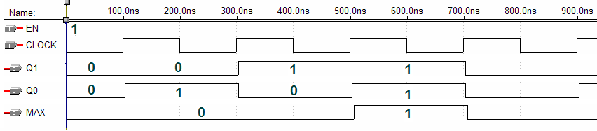
Timing diagram
Note: analysis of finite-state machine should be base on the clock tick.
Before the clock tick (or active trigger level), the state is current state;
After the clock tick (or on the active trigger level), the state is next state.

Slide 54
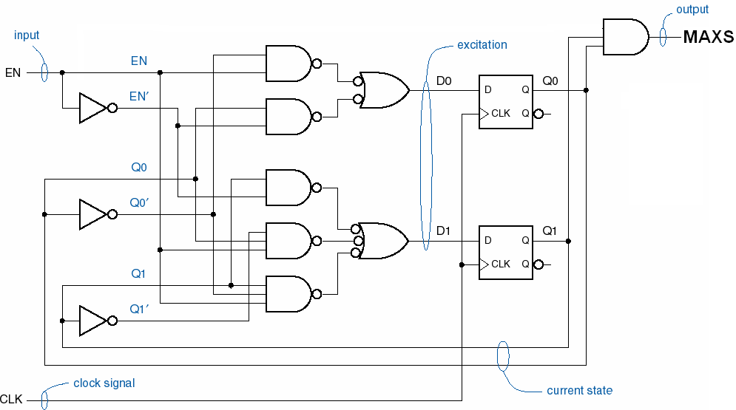
Analysis of Moore maching
MAXS=Q1·Q0
excitation equations and transition equations are unchanged

Slide 55
transition table
state table
Q1Q0 | EN |  | MAXS
 | 0 | 1
00 | 00 | 01 | 0
01 | 01 | 10 | 0
10 | 10 | 11 | 0
11 | 11 | 00 | 1
 | Q1*Q0* （next state）
S | EN |  | MAXS
 | 0 | 1
A | A | B | 0
B | B | C | 0
C | C | D | 0
D | D | A | 1
 | S*
independent of input values

Slide 56
state diagram
show output value inside the circle
A MAXS=0
B MAXS=0
EN=1
EN=0
EN=0
EN=1
EN=1
D MAXS=1
EN=1
C MAXS=0
EN=0
EN=0

Slide 57
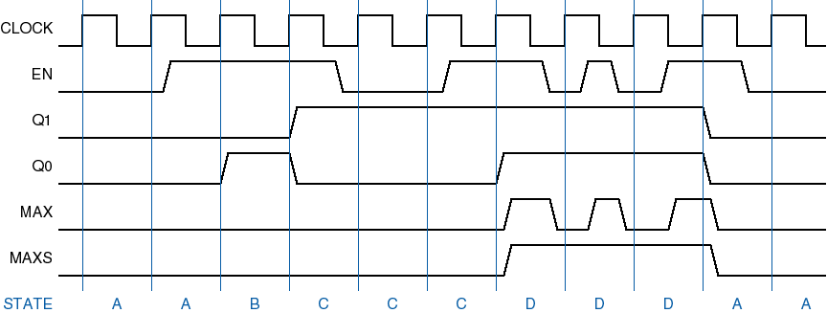
Timing diagram’s comparison

Slide 58
state transition feature
transition expressions (input combinations) on arcs leaving a particular state must be mutually exclusive (互斥) and all inclusive（完备）.
No two transition expressions can equal 1 for the same input combination;
For every possible input combination, some transition expression must equal 1.
transition expression
S0
I1
S1
Ii
…
In
…
Si
Sn

Slide 59
3、analysis with J-K flip-flops
X
Z
J0
Q0
J1
Q1
1
J
Q
J
Q
CLK
CLK
K0
Q
K1
K
K
Q
CP
(1) excitation equation：
J0=K0=1
J1=K1=X⊕Q0
(2) transition equation:
Q0*=J0·Q0’+K0’·Q0=Q0’
Q1*=J1·Q1’+K1’·Q1 =X⊕Q0⊕Q1

Slide 60
(3) output equation：Z=Q0·Q1
(4) transition/output table and state/output table
 | X |  | Z
Q1Q0 | 0 | 1
00 | 01 | 11 | 0
01 | 10 | 00 | 0
10 | 11 | 01 | 0
11 | 00 | 10 | 1
 | Q1*Q0*
 | X |  | Z
S | 0 | 1
A | B | D | 0
B | C | A | 0
C | D | B | 0
D | A | C | 1
 | S*
assign state name：
Q1Q0 S 00 A 01 B 10 C 11 D

Slide 61
state diagram
Circuit’s logic function:
2-bit up/down counter
X=1
A Z=0
B Z=0
X=0
X
X’
X
X’
D Z=1
X’
C Z=0
X

Slide 62
timing diagram
CP
X
Q1
Q0
Z
 | X |  | Z
Q1Q0 | 0 | 1
00 | 01 | 11 | 0
01 | 10 | 00 | 0
10 | 11 | 01 | 0
11 | 00 | 10 | 1
 | Q1*Q0*

Slide 63
Exp3：analyze the following circuit
Z
T1
Q1
T2
Q
Q2
X
T
Q
T
CLK
CLK
Q
Q
CLK
(1) excitation equation：
T1=X
T2=X·Q1
(2) transition equation：
Q1*=T1·Q1’+T1’·Q1= X·Q1’+X’·Q1
Q2*= T2·Q2’+T2’·Q2= X·Q1·Q2’+（X·Q1）’·Q2
(3) output equation：Z=X·Q1·Q2

Slide 64
7.4 clocked synchronous state-machine design
Construct state/output table
State minimization
Construct excitation table
State assignment
Deriving excitation equation
Construct transition/output table
Deriving output equation
Choose flip-flops
Drawing logic circuit diagram

Slide 65
Exp1: sequence-detector design
Design a clocked synchronous state machine. if a continuous “110” sequence is included in the serial input binary numbers, the circuit output 1. synthesis by D flip-flops . that is
input P：
output C：
solution ：Moore machine
（1）input and output variable
input：P（a bit sent into the circuit）
output：C（the detecting result, 1 bit）
first input
0 | 1 | 1 | 0 | 0 | 1 | 0 | 1 | 1 | 1 | 0 | 1 | 0
0 | 0 | 0 | 1 | 0 | 0 | 0 | 0 | 0 | 0 | 1 | 0 | 0

Slide 66
state analysis of exp.1
P：
0 | 1 | 1 | 0 | 0 | 1 | 0 | 1 | 1 | 1 | 0 | 1 | 0
task：detect section 110
C：
0 | 0 | 0 | 1 | 0 | 0 | 0 | 0 | 0 | 0 | 1 | 0 | 0
If the previous one input bit is 0, then memory as a state, S0
If the previous one input bit is 0, then memory as a state, S1
Input 0
Input 1
If the previous two input bit is 01, also memory as state S0
If the previous one input bit is 1, then memory as a state, S2
If the previous two input bit is 1, then memory as a state, S3
If the previous two input bit is 1, also memory as state S2

Slide 67
Exp1: sequence-detector design
Defining states：
S0 — received a single 0
S1 — received a single 1
S2 — received a continuous “11”
S3— received a continuous “110”
state/output table
S | P |  | C
 | 0 | 1
S0 | S0 | S1 | 0
S1 | S0 | S2 | 0
S2 | S3 | S2 | 0
S3 | S0 | S1 | 1
 | S*

Slide 68
（2）state minimization
（3）state assignment（状态的分配、赋值）
n state variables → 2^{n} states。
Then, S states need (?) state variables (flip-flops) to represent.
The number of f-fs：m=2，named Q0、Q1
Assign state variable combinations to each symbol state：
S： S0 S1 S2 S3
Q1Q0： 00 01 10 11
at least
different assignment
☟
different circuit

Slide 69
(4) construct transition/output table
substitute state combinations for the state symbols .
Q1Q0 | P |  | C
 | 0 | 1
00 | 00 | 01 | 0
01 | 00 | 10 | 0
10 | 11 | 10 | 0
11 | 00 | 01 | 1
 | Q1*Q0*
S0
S | P |  | C
 | 0 | 1
S0 | S0 | S1 | 0
S1 | S0 | S2 | 0
S2 | S3 | S2 | 0
S3 | S0 | S1 | 1
 | S*
S1
S2
S3

Slide 70
(5) Construct excitation table
Choose flip-flops and use application equation to construct excitation table.
Q | D | Q*
0 | 0 | 0
0 | 1 | 1
1 | 0 | 0
1 | 1 | 1
Q | Q* | D
0 | 0 | 0
0 | 1 | 1
1 | 0 | 0
1 | 1 | 1
Application equation：D=Q*
Q1Q0 | P |  | C
 | 0 | 1
00 | 00 | 01 | 0
01 | 00 | 10 | 0
10 | 11 | 10 | 0
11 | 00 | 01 | 1
 | D1D0
Function table of D f-f-s
Application table
Excitation table

Slide 71
(6) Deduce the excitation equations
Q1Q0 | P |  | C
 | 0 | 1
00 | 00 | 01 | 0
01 | 00 | 10 | 0
10 | 11 | 10 | 0
11 | 00 | 01 | 1
 | D1D0
D1
Q1Q0
Q1
P
0
0
0
1
0
1
0
1
Q0
D0
Q1Q0
Q1
P
0
0
0
1
1
0
1
0
D1=Q1·Q0’+Q1’·Q0·P
D0=Q1·Q0’·P+Q1’·Q0’·P+Q1·Q0·P
Q0

Slide 72
(7) Deduce the output equation
Q1Q0 | P |  | C
 | 0 | 1
00 | 00 | 01 | 0
01 | 00 | 10 | 0
10 | 11 | 10 | 0
11 | 00 | 01 | 1
 | Q1*Q0*
C=Q1·Q0

Slide 73
Circuit for exp1
4
U1A
D1
PR
Q1
2
D
Q
5
C
P
3
CLK
Q
6
CLR
1
74HC74D_6V
4
U2B
D0
PR
Q0
2
D
Q
5
3
CLK
Q
6
CLR
1
74HC74D_6V
CLK

Slide 74
Assignment 2
Issue: if we adapt Gray code for state assignment, then what the circuit is?
S： S0 S1 S2 S3
Q1Q0：00 01 11 10
S | P |  | C
 | 0 | 1
S0 | S0 | S1 | 0
S1 | S0 | S2 | 0
S2 | S3 | S2 | 0
S3 | S0 | S1 | 1
 | S*
Q1Q0 | P |  | C
 | 0 | 1
00 | 00 | 01 | 0
01 | 00 | 11 | 0
11 | 10 | 11 | 0
10 | 00 | 01 | 1
 | Q1*Q0*

Slide 75
Assignment with Gray code
Q1Q0 | P |  | C
 | 0 | 1
00 | 00 | 01 | 0
01 | 00 | 11 | 0
11 | 10 | 11 | 0
10 | 00 | 01 | 1
 | D1 D0
D0
Q1Q0
Q1
P
0
0
0
0
1
1
1
1
Q0
D1
Q1Q0
Q1
P
0
0
1
0
D0=P
D1=Q1·Q0+Q0·P
0
1
1
0
Q0

Slide 76
Another sequence detector : use mealy machine
(2) Construct state/output table
If a circuit’s input P receives continuous 101 binary sequence, then C output 1, otherwise C output 0. And overlap is not permitted.
（1）defining states
S0—receive a single 0，C=0
S1—receive a single 1，C=0
S2—receive continuous “10”，C=0
S3—receive continuous “101”，C=1
S | P
 | 0 | 1
S0 | S0，0 | S1，0
S1 | S2，0 | S1，0
S2 | S0，0 | S3，1
S3 | S0，0 | S1，0
 | S*，C

Slide 77
(3) State minimization
S0 and S3 are equivalent states，so eliminate S3, and get the minimized state/output table.
S | P
 | 0 | 1
S0 | S0，0 | S1，0
S1 | S2，0 | S1，0
S2 | S0，0 | S3，1
S3 | S0，0 | S1，0
 | S*，C
Equivalent states: two states produce the same values at the output; and they have either the same next state or equivalent next state.（section 7.4.2）
S0

Slide 78
(4) State assignment
Number of f-fs：
named Q1、Q0 Q1Q0=00，01，10，11
assign 3 of the 4 binary values to the 3 known states。like， S0 — 00，S1 —01，S2 — 11 Q1Q0=10，unused state.
Transition/output table
Q1Q0 | P
 | 0 | 1
00 | 00，0 | 01，0
01 | 11，0 | 01，0
11 | 00，0 | 00，1
10 | ？ | ？
 | Q1*Q0*，C

Slide 79
Disposition of unused states
①minimal risk
②minimal cost
Q1Q0 | P
 | 0 | 1
00 | 00，0 | 01，0
01 | 11，0 | 01，0
11 | 00，0 | 00，1
10 | 00，0 | 00，0
 | Q1*Q0*，C
Q1Q0 | P
 | 0 | 1
00 | 00，0 | 01，0
01 | 11，0 | 01，0
11 | 00，0 | 00，1
10 | dd，d | dd，d
 | Q1*Q0*，C

Slide 80
(5) Construct excitation table
Use D f-fs and in minimal cost disposition.
Application equation：D=Q*
Q1Q0 | P
 | 0 | 1
00 | 00,0 | 01,0
01 | 11,0 | 01,0
11 | 00,0 | 00,1
10 | dd,d | dd,d
 | D1D0,C
Excitation table

Slide 81
(6) Derive the excitation equations and output equation
D1=Q1’ ·Q0·P’
D0=P·Q1’+Q1’ ·Q0
C=Q1·P

Slide 82
another way: synthesis using J-K f-fs
Also for detecting continuous 101 sequence.
Q1Q0 | P
 | 0 | 1
00 | 0d,0d,0 | 0d,1d,0
01 | 1d,d0,0 | 0d,d0,0
11 | d1,d1,0 | d1,d1,1
10 | dd,dd,d | dd,dd,d
 | J1K1,J0K0,C
Q | Q* | J | K
0 | 0 | 0 | d
0 | 1 | 1 | d
1 | 0 | d | 1
1 | 1 | d | 0
Minimal cost disposition
Application table of J-K f-fs
Excitation table

Slide 83
Excitation equations and output equation
Excitation equations
J1=P’·Q0 K1=1
J0=P K0=Q1
output equation
C=Q1·P
J0
4
15
Q0
C
P
1J
1Q
clk
1
1CLK
K0
16
14
1K
1Q
J1
Q1
4
1J
1Q
15
1
1CLK
VCC
K1
16
14
1K
1Q

Slide 84
Design examples in book
Exp1:
Design a machine inputs A and B with output Z that is 1 if:
A had the same value at the two previous ticks
B has been 1 since the last time the above was true ）
CLK
A
B
Z

Slide 85
1. Find states
电路开始工作，设置INIT状态，Z=0
状态A0，A收到一个0，……，Z=0
状态A1，A收到一个1，……，Z=0
状态OK0，A收到连续的两个0，Z=1
状态OK1，A收到连续的两个1，Z=1
状态A001，A收到连续的两个0后，收到1，同时B=1，Z=1
状态A110，A收到连续的两个1后，收到0，同时B=1，Z=1
状态AE10，A已经收到过连续的00或11，收到连续的10，同时B=1，Z=1
状态AE01，A已经收到过连续的00或11，收到连续的01，同时B=1，Z=1

Slide 86
电路开始工作，设置INIT状态，Z=0
状态A0，A收到第一个0，Z=0
状态A1，A收到第一个1，Z=0
状态OK0，A收到连续的两个0，Z=1
状态OK1，A收到连续的两个1，Z=1
状态A001，A收到连续的两个0后，收到1，同时B=1，Z=1
状态A110，A收到连续的两个1后，收到0，同时B=1，Z=1
状态AE10，A已经收到过连续的00或11，收到连续的10，同时B=1，Z=1
状态AE01，A已经收到过连续的00或11，收到连续的01，同时B=1，Z=1
S | A B |  |  |  | Z
 | 00 | 01 | 11 | 10
INIT | A0 | A0 | A1 | A1 | 0
A0 | OK0 | OK0 | A1 | A1 | 0
A1 | A0 | A0 | OK1 | OK1 | 0
OK0 | OK0 | OK0 | A001 | A1 | 1
OK1 | A0 | A110 | OK1 | OK1 | 1
A001 | A0 | AE10 | OK1 | OK1 | 1
A110 | OK0 | OK0 | AE01 | A1 | 1
AE10 | OK0 | OK0 | AE01 | A1 | 1
AE01 | A0 | AE10 | OK1 | OK1 | 1
 | S*

Slide 87
State minimization
S | A B |  |  |  | Z
 | 00 | 01 | 11 | 10
INIT | A0 | A0 | A1 | A1 | 0
A0 | OK0 | OK0 | A1 | A1 | 0
A1 | A0 | A0 | OK1 | OK1 | 0
OK0 | OK0 | OK0 | A001 | A1 | 1
OK1 | A0 | A110 | OK1 | OK1 | 1
A001 | A0 | AE10 | OK1 | OK1 | 1
A110 | OK0 | OK0 | AE01 | A1 | 1
AE10 | OK0 | OK0 | AE01 | A1 | 1
AE01 | A0 | AE10 | OK1 | OK1 | 1
 | S*
Equivalent states，eliminate state AE01
Equivalent states, eliminate state AE10

Slide 88
State minimization
S | A B |  |  |  | Z
 | 00 | 01 | 11 | 10
INIT | A0 | A0 | A1 | A1 | 0
A0 | OK0 | OK0 | A1 | A1 | 0
A1 | A0 | A0 | OK1 | OK1 | 0
OK0 | OK0 | OK0 | A001 | A1 | 1
OK1 | A0 | A110 | OK1 | OK1 | 1
A001 | A0 | A110 | OK1 | OK1 | 1
A110 | OK0 | OK0 | A001 | A1 | 1
 | S*
Equivalent states，eliminate state A110
Equivalent states, eliminate state A001

Slide 89
Minimal state table
S | A B |  |  |  | Z
 | 00 | 01 | 11 | 10
INIT | A0 | A0 | A1 | A1 | 0
A0 | OK0 | OK0 | A1 | A1 | 0
A1 | A0 | A0 | OK1 | OK1 | 0
OK0 | OK0 | OK0 | OK1 | A1 | 1
OK1 | A0 | OK0 | OK1 | OK1 | 1
 | S*

Slide 90
State assignment
Possible state assignments
 | assignment
State name | Simplest Q1~Q3 | Decomposed Q1~Q3 | One-hot Q1~Q5 | Almost one-hot Q1~Q4
INIT | 000 | 000 | 00001 | 0000
A0 | 001 | 100 | 00010 | 0001
A1 | 010 | 101 | 00100 | 0010
OK0 | 011 | 110 | 01000 | 0100
OK1 | 100 | 111 | 10000 | 1000
Q1=0, in the INIT state
Q1=1, in the non-INIT state
In the non-INIT state,
Q3 give the previous value of A;
Q2 indicates that the conditions for a 1 output are satisfied in the current state.

Slide 91
Transition/output table and excitation table
Q1Q2Q3 | A B |  |  |  | Z
 | 00 | 01 | 11 | 10
000 | 100 | 100 | 101 | 101 | 0
100 | 110 | 110 | 101 | 101 | 0
101 | 100 | 100 | 111 | 111 | 0
110 | 110 | 110 | 111 | 101 | 1
111 | 100 | 110 | 111 | 111 | 1
 | D1 D2 D3
Q1Q2Q3 | A B |  |  |  | Z
 | 00 | 01 | 11 | 10
000 | 100 | 100 | 101 | 101 | 0
100 | 110 | 110 | 101 | 101 | 0
101 | 100 | 100 | 111 | 111 | 0
110 | 110 | 110 | 111 | 101 | 1
111 | 100 | 110 | 111 | 111 | 1
 | Q1*Q2*Q3*

Slide 92
Completed excitation table
Q1Q2Q3 | A B |  |  |  | Z
 | 00 | 01 | 11 | 10
000 | 100 | 100 | 101 | 101 | 0
001
010
011
100 | 110 | 110 | 101 | 101 | 0
101 | 100 | 100 | 111 | 111 | 0
110 | 110 | 110 | 111 | 101 | 1
111 | 100 | 110 | 111 | 111 | 1
 | D1 D2 D3
Disposition of unused states
？
Two approaches:
Minimal cost
Minimal risk

Slide 93
D1
AB
00
01
11
10
Q2Q3
00
1
1
1
1
Q1Q2Q3 | A B |  |  |  | Z
 | 00 | 01 | 11 | 10
000 | 100 | 100 | 101 | 101 | 0
001 |  |  |  |  | 0
010 |  |  |  |  | 0
011 |  |  |  |  | 0
100 | 110 | 110 | 101 | 101 | 0
101 | 100 | 100 | 111 | 111 | 0
110 | 110 | 110 | 111 | 101 | 1
111 | 100 | 110 | 111 | 111 | 1
 | D1 D2 D3
01
0
0
0
0
11
0
0
0
0
Minimal risk
Q1=0
0
0
0
0
10
D1
AB
00
01
11
10
Q2Q3
00
1
1
1
1
01
1
1
1
1
11
1
1
1
1
D1=Q1+Q2’Q3’
D2, D3……
Z=Q1·Q2
Q1=1
10
1
1
1
1

Slide 94
D1
AB
00
01
11
10
Q2Q3
Q1Q2Q3 | A B |  |  |  | Z
 | 00 | 01 | 11 | 10
000 | 100 | 100 | 101 | 101 | 0
001 |  |  |  |  | d
010 |  |  |  |  | d
011 |  |  |  |  | d
100 | 110 | 110 | 101 | 101 | 0
101 | 100 | 100 | 111 | 111 | 0
110 | 110 | 110 | 111 | 101 | 1
111 | 100 | 110 | 111 | 111 | 1
 | D1 D2 D3
00
1
1
1
1
01
d
d
d
d
11
d
d
d
d
Minimal cost
Q1=0
d
d
d
d
10
D1
AB
00
01
11
10
Q2Q3
00
1
1
1
1
01
1
1
1
1
11
1
1
1
1
Q1=1
10
1
1
1
1
D1=1
D2,D3……
Z=Q2

Slide 95
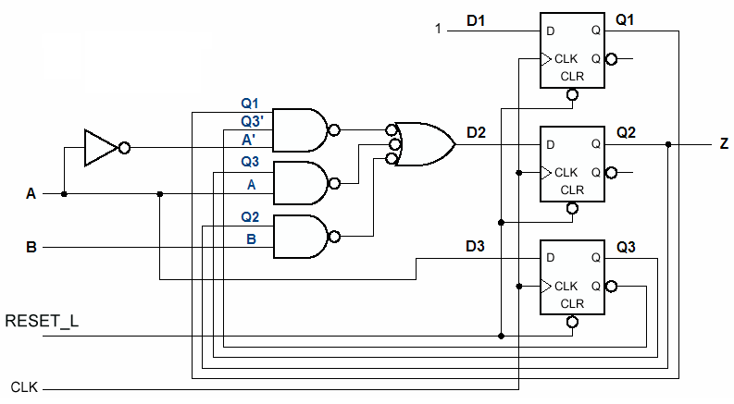
Logic diagram in minimal cost for Exp1

Slide 96
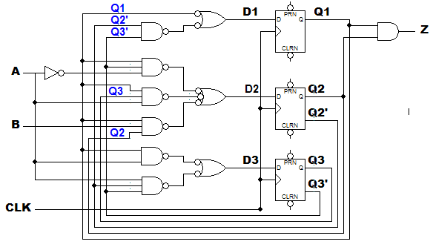
Logic diagram in minimal risk for Exp1

Slide 97
Exp2: 1s-counting machine
design a clocked synchronous state-machine with two inputs X and Y, and one output Z, the output should be 1 if the number of 1 inputs on X and Y since reset is a multiple of 4, and 0 otherwise.
reset
X | 0 | 0 | 0 | 1 | 0 | 0 | 1 | 1 | 1 | 0 | 0 | 1 | 0
Y | 0 | 0 | 0 | 0 | 1 | 1 | 0 | 0 | 1 | 1 | 0 | 0 | 1
Z |  | 1 | 1 | 0 | 0 | 0 | 1 | 0 | 0 | 1 | 1 | 0 | 0

Slide 98
Naming state
Each state record the number of 1 input on X and Y：
Multiple of 4 imply that the number of 1 input can be divided by 4. (MOD 4=0)
(N MOD 4) =0，— Z=1 —— S0
(N MOD 4) =1，— Z=0 —— S1
(N MOD 4) =2，— Z=0 —— S2
(N MOD 4) =3，— Z=0 —— S3

Slide 99
Synthesis steps
1、state/output table
2、state assignment:
S0 — 00、S1 — 01、 S2 — 11、S3 — 10
S | XY |  |  |  | Z
 | 00 | 01 | 11 | 10
S0 | S0 | S1 | S2 | S1 | 1
S1 | S1 | S2 | S3 | S2 | 0
S2 | S2 | S3 | S0 | S3 | 0
S3 | S3 | S0 | S1 | S0 | 0
 | S*
3、transition/output table
……
4、application table
……
……

Slide 100
Exp3: a combination lock
requirement:
UNLK=1 if and only if X is 0 and the sequence of inputs received on X at the preceding seven clock ticks of X was 0110111.
HINT=1 if and only if the current value of X is the correct one to move the machine closer to being in the “unlocked” state (with UNLK=1).
It is a sequence-detector machine

Slide 101
States analysis
X | 0 | 1 | 0 | 0 | 1 | 1 | 0 | 0 | 1 | 0 | 1 | 1 | 0 | 1 | 1 | 1 | 0
UNLK | 0 | 0 | 0 | 0 | 0 | 0 | 0 | 0 | 0 | 0 | 0 | 0 | 0 | 0 | 0 | 0 | 1
HINT | 1 | 1 | 0 | 1 | 1 | 1 | 1 | 0 | 0 | 1 | 1 | 1 | 1 | 1 | 1 | 1 | 1
Input state output
Got 1 A UNLK=0, HINT=0
Got 0 B UNLK=0, HINT=1
Got 01 C UNLK=0, HINT=1
Got 011 D UNLK=0, HINT=1
Got 0110 E UNLK=0, HINT=1
Got 01101 F UNLK=0, HINT=1
Got 011011 G UNLK=0, HINT=1
Got 0110111 H UNLK=0, HINT=1
Got 01101110 I UNLK=1, HINT=1

Slide 102
State table for combination-lock machine
S | X
 | 0 | 1
A | B，01 | A，00
B | B，00 | C，01
C | B，00 | D，01
D | E，01 | A，00
E | B，00 | F，01
F | B，00 | G，01
G | E，01 | H，01
H | I，11 | A，00
I | B，00 | C，01
 | S*，UNLK HINT
S | X
 | 0 | 1
A | B，01 | A，00
B | B，00 | C，01
C | B，00 | D，01
D | E，01 | A，00
E | B，00 | F，01
F | B，00 | G，01
G | E，01 | H，01
H | B，11 | A，00
 | S*，UNLK HINT
Equivalent states
Omit the later steps.
……

Slide 103
7.5 designing state machines using state diagram
Difference between state table and state diagram design：
状态表是穷举列表的方法
状态图表达状态的转移用一条带转移表达式的弧线，其中可能包含多个输入。经常不能一次达到状态转移的完备性。

Slide 104
Exp1: a sequence-detector, if the control input A =1, and serial input B are continuous “110”, then output C =1.
A,B/C
A’/0
S
A’/0
A’/0
S₀
A,B/0
S₂
A,B/0
S₃
A,B’/1
S₄
A’/0
A’/0
A,B’/0
A,B/0
A,B/0
S₁
A,B’/0
A,B/0
A,B’/0
A,B’/0

Slide 105
Equivalent states in state diagram：
if two node’s directed arc for a given input combination point to the same nodes, then they are equivalent states.
S₀ and S₁are equivalent states here。
A’+A·B’/0
A’/0
A’+ A·B’/ 0
S₁
A,B/0
S₂
A,B/0
S₃
A,B’/1
S₄
A’+ A·B’/0
A,B/0
A,B/0

Slide 106
state assignment
construct transition/output table and derive the excitation table.
Q1Q0 | AB
 | 00 | 01 | 11 | 10
00 | 00，0 | 00，0 | 01，0 | 00, 0
01 | 00，0 | 00，0 | 11，0 | 00, 0
11 | 00，0 | 00，0 | 11，0 | 10, 1
10 | 00，0 | 00，0 | 01，0 | 00, 0
 | Q1*Q0*，C
S₁
S₂
D=Q*
S₃
S₄

Slide 107
Q1Q0 | AB
 | 00 | 01 | 11 | 10
00 | 00，0 | 00，0 | 01，0 | 00, 0
01 | 00，0 | 00，0 | 11，0 | 00, 0
11 | 00，0 | 00，0 | 11，0 | 10, 1
10 | 00，0 | 00，0 | 01，0 | 00, 0
 | D1 D0，C
D1=A·B·Q0+A·Q1·Q0
D0=A·B
C=A·B’ ·Q1·Q0

Slide 108
Exp2:T-bird tail lights
input：L（LEFT）、R（RIGHT）、H（HAZ）
output：LA、LB、LC、RA、RB、RC
Working condition：
input L — LA、LB、LC lighting on successively and off
input R — RA、RB、RC lighting on successively and off；
input H — all lights flashing on and off in unison
no input, all lights off.
LC
LB
LA
RA
RB
RC
state | description
L1 | LA on
L2 | LA、LB on
L3 | LA、LB、LC on
R1 | RA on
R2 | RA、RB on
R3 | RA、RB、RC on
LR3 | all on simultaneous
IDLE | all off

Slide 109
First State diagram
Some faulty aspect
……
Thinking carefully
L2
1
1
L3
L1
1
L=1
 | input
S | H | L | R | S*
IDLE | 1 | × | × | LR3
IDLE | × | 1 | 1 | LR3
IDLE | 0 | 1 | 0 | L1
IDLE | 0 | 0 | 1 | R1
IDLE | 0 | 0 | 0 | IDLE
IDLE
H=1
LR3
H’L’R’
1
1
R=1
R3
R1
1
1
R2

Slide 110
Corrected diagram
L2
1
1
L3
L1
1
H’LR’
IDLE
H+LR
LR3
H’L’R’
1
1
H’L’R
R3
R1
1
1
R2

Slide 111
Corrected diagram again
L2
H
H’
H’
L3
L1
1
H’LR’
H
IDLE
H+LR
LR3
H’L’R’
1
1
H’L’R
H
R3
R1
H’
H’
R2
H

Slide 112
State assignment
8 states，need 3 f--fs，so named Q0、Q1、Q2。
Assign state：
S — IDLE L1 L2 L3 R1 R2 R3 LR3
Q2Q1Q0 — 000 001 011 010 101 111 110 100
transition list :
Each row contains the current state, next state and transition expression（p.427 table 7-14）
Derive transition equation：
Transition list can be viewed as a sort of truth table
Current state Q2, Q1, Q0 and transition expressions (input combinations) are input variables
Next state Q2*, Q1*, Q0* are output variables

Slide 113
Summary for chapter 7
Basic sequence element
Latches
Flip-flops
Latches and flip-flops are used as state storage.
State machine structure
Mealy machine
Moore machine

Slide 114
Important features
Excitation signal, excitation equations
Transition equations
Output equations
Transition/output table
State/output table
State diagram
Timing diagram

Slide 115
课堂练习
已知某同步时序电路的转移方程、输出方程如下，请写出其转移/输出表，并画出状态图，试说明其功能。状态变量赋值按Q1Q0=00、01、10、11。
Q1*=X’·Q0·Q1’+X’·Q1
Q0*=X’·Q0’+X’·Q1·Q0
Y=Q0·Q1

Slide 116
Class exercise
若某电路输入端的串行序列X是1101时，输出L=1，否则L=0。
试写出该电路的Mealy machine 和Moore machine 的状态/输出表。

